Slide 1
Autumn safety tips
September 2024

Slide 2

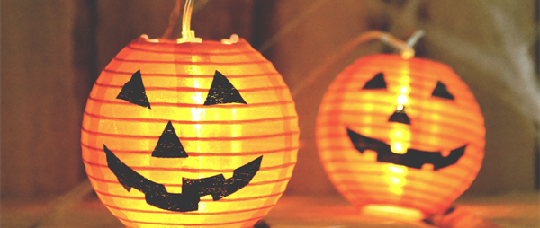
Halloween
How to keep children safe this Halloween | 12 top tips (capt.org.uk)
Halloween can be an exciting time of year for children, dressing up and going out after dark but…
Remember Halloween costumes are highly flammable
Many fancy dress costumes are not manufactured to the same safety standards as normal clothing, meaning they can ignite almost instantly and burn far faster.
That’s why it is crucial to ensure children wearing Halloween costumes are kept well away from naked flames and other heat sources at all times.
Try to buy costumes from a reputable store or website
It may mean spending a bit more but buying from a reputable store or website will be safer. Cheap costumes may not meet UK safety standards and may carry fake safety label. Look for Fire safety label: UKCA or CE mark
Keep candles well out of the path of trick or treater

Slide 3
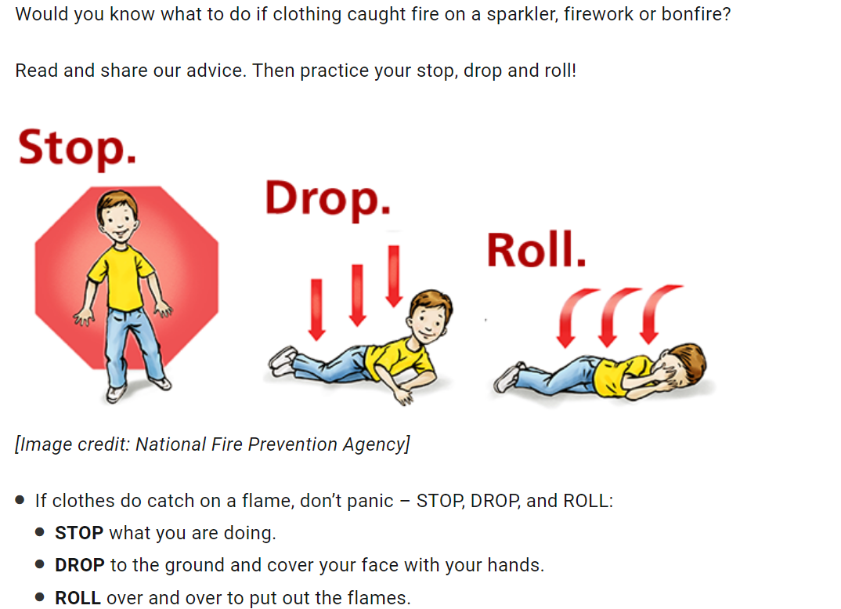
Know what to do if your childs clothing caught on fire?
Stop, drop and roll | Child Accident Prevention Trust (capt.org.uk)

Slide 4
Halloween 2
Be visible
On average, children are more than twice as likely to be hit by a car and killed on Halloween than on any other day of the year. Halloween Safety | Safe Kids Worldwide
Visibility is important all year round. However, after the clocks go back, it gets dark much earlier. By Halloween it will be dusk by 5 o’clock, just when children are out trick or treating.
Reflective tape can make a fun addition to Halloween costumes and make children more visible to drivers at twilight, as it is picked up in car headlights.
Fluorescent glow sticks and glow jewellery can make good costume accessories and can also help make children more visible to drivers.
If you’re going out earlier with little ones, then bright or fluorescent clothing is better for daytime visibility.
Stay safe near roads
Masks can make it harder for children to see or hear traffic. So, save the special masks for indoors and use face paint for trick or treating.
Crave carefully
Carving pumpkins has become a great Halloween tradition. If your child isn’t old enough to handle a sharp knife safely there are plenty of ‘no-carve pumpkin’ ideas
Watch out for treats that might be a choking hazard for young children
Safe from choking | How to prevent choking in children (capt.org.uk)

Slide 5

Firework safety
Firework safety advice hub | Safe fireworks for families (capt.org.uk)
In 2022/2023 emergency services attended 32 casualties of firework accidents. victims-fires-with-fireworks-by_injury-severity-and-type-2010-2023.ods (live.com).
Don’t go back to a firework once it has been lit. Sometimes they can be very slow to get started and may take you by surprise, blowing up in your face.
Use a rope for children to stand behind at a safe distance from your display.
Bonfires should be at least 60 meters from trees/hedges/buildings and never throw used fireworks into a bonfire in case there is more gunpowder in them.
Store fireworks in a box until ready to use them, light at arm’s length and avoid alcohol.

Slide 6

Sparkler safety
It is recommended that sparklers are not given to under-5s
Make sure everyone handling sparklers wears gloves
Hold sparklers at arm’s length while being lit and light them one at a time
Don’t wave sparklers about close to other people
Never hold a baby in your arms while you are holding a sparkler
When the sparkler has finished put it in a bucket of cold water.
Firework safety - RoSPA

Slide 7

Did you know?
Fireworks can travel at speeds of up to 150mph.
Throwing a firework is a criminal offence and you can be fined up to £5000.
Most injuries are to the eyes, head or hands – so children will have visible scars for life.
Most injuries happen at private or family displays.
Rocket, air bomb and sparkler incidents are the most common.
Over 550 children under 16 are taken to A&E in the four weeks surrounding bonfire night alone.
Many more boys than girls are injured by fireworks – especially boys aged 12 to 15 years. Fireworks - Children's Burns Trust (cbtrust.org.uk)

Slide 8

General fireworks safety tips
Find an organised firework display in your area – it is safer to attend an organised fireworks display run by experts.
Check that dressing up costumes have a CE mark Firework safety tips: How to have safe fireworks at home (capt.org.uk).
Your child should not "help out" with your fireworks display.
Keep a bucket of water handy in case of an accident.
Avoid loose clothing and tie back long hair
After the party, pour water on the fire, rather than leaving it to burn out. Firework safety – RoSPA
Check the category of your fireworks as some may not be suitable for your garden Firework safety – RoSPA
How to buy fireworks safely UK: A Fireworks buying guide (capt.org.uk)
Keep pets indoors.

Slide 9
Burns… what to do
Stop the burning process as soon as possible. This may mean removing the person from the area, dousing flames with water, or smothering flames with a blanket. Do not put yourself at risk of getting burnt as well.
Remove any clothing or jewellery near the burnt area of skin, including babies' nappies. But do not try to remove anything that's stuck to the burnt skin, as this could cause more damage.
Cool the burn with cool or lukewarm running water for 20 minutes as soon as possible after the injury. Never use ice, iced water, or any creams or greasy substances like butter.
Keep yourself or the person warm. Use a blanket or layers of clothing but avoid putting them on the injured area.
Cover the burn with cling film. Lay the cling film over the burn, rather than wrapping it around a limb. A clean, clear plastic bag can be used for burns on your hand.
Treat the pain from a burn with paracetamol or ibuprofen. Always check the manufacturer's instructions when using over-the-counter medication. Children under 16 years of age should not be given aspirin.
Raise the affected area, if possible. This will help to reduce swelling.
Burns and scalds - Treatment - NHS (www.nhs.uk)

Slide 10
When to go to hospital…
Once you have taken these steps: Go to a hospital accident and emergency for:
large burns bigger than the size of the affected person's hand
deep burns of any size that cause white or charred skin
burns on the face, neck, hands, feet, any joints, or genitals
all chemical and electrical burns
any signs of shock – symptoms include cold, clammy skin, sweating, rapid, shallow breathing, and weakness or dizziness
You should also go to hospital for all burns if you or the person who has been burned is:
under the age of 10
has a medical condition, such as heart, lung or liver disease, or diabetes
has a weakened immune system (the body's defence system) – for example, because of HIV or AIDS, or because they're having chemotherapy for cancer
If someone has breathed in smoke or fumes, they should also get medical attention at hospital.
Some symptoms may be delayed, and can include:
coughing/ sore throat/difficulty breathing/singed nasal hair/facial burns
Burns and scalds - Treatment - NHS (www.nhs.uk)

Slide 11
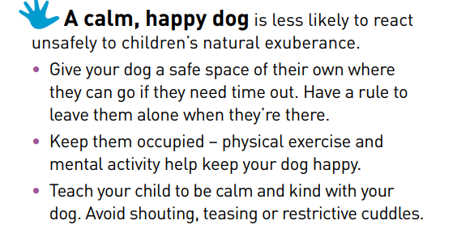
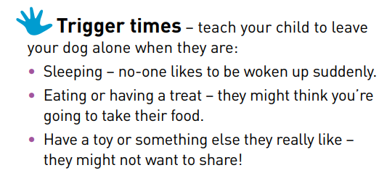
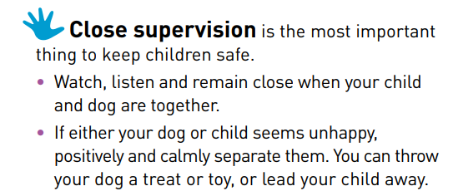
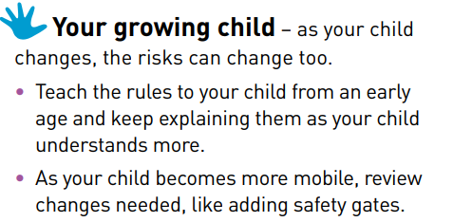
Dog Bites
Child-safety-around-dogs-fact-sheet-2023.pdf (capt.org.uk)
Last year 1,700 children were admitted to hospital after being bitten by a dog
Children are most likely to be bitten at home, by a familiar dog.
“what size or breed they are. We don’t ever expect our own dogs to bite, but all dogs can ,,

Slide 12
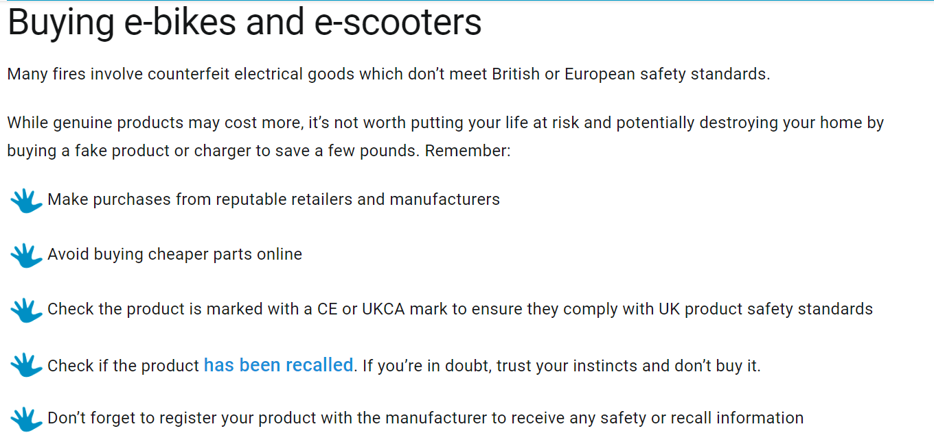
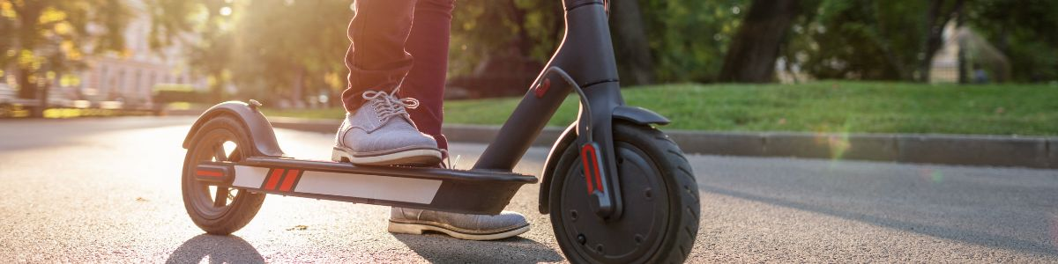
E-bikes and e-scooters: Fire safety
E-bikes and e-scooters: Fire safety tips (capt.org.uk)

Slide 13

Road Safety
Road casualty rates increase with the arrival of darker evenings and worsening weather conditions.
Every autumn when the clocks go back and sunset occurs earlier in the day, road casualties rise. The effects are worse for the most vulnerable road users like children, the elderly, cyclists and motorcyclists. RoSPA BST Factsheet
Crashes rise by 23% in autumn months compared to summer months
Slippery roads due to weather contributed to more than 4,000 collisions last year Crashes Rise A Quarter When Clocks Go Back | AA (theaa.com)
1,766 people were killed (1,711 in Britain, 55 in NI) and 28,941 were seriously injured (28,031 in Britain, 910 in NI). Reported road casualties Great Britain, annual report: 2022 - GOV.UK (www.gov.uk)

Slide 14
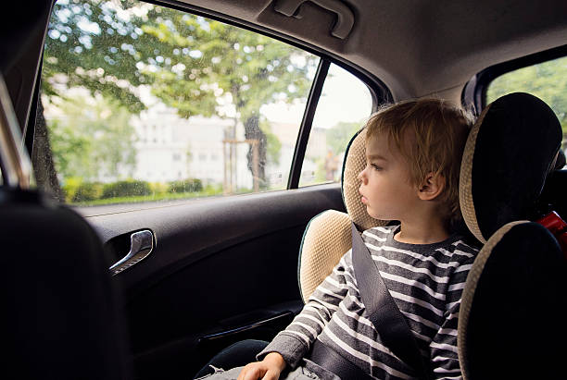
Tips to stay safe
Using a car seat can save your child’s life in an accident. Car seat safety: A guide to keeping your child safe in the car (capt.org.uk)
Always take advantage of any hands-free technologies available in your vehicle.
If you’re distracted by other drivers on the road, or you need to take an important phone call, know when to pull over.
If visibility is reduced, slow down. If you’re still not comfortable, pull over and wait for it to improve.
Fatigued driving can be just as dangerous as driving under the influence. Get a good night of sleep and know when to pull over to rest
Be more cautious around schools and poorly lit areas – always check for cyclists and pedestrians.
Ensure your headlights and wipers work well before heading out on the road.
Check the weather before leaving.

Slide 15
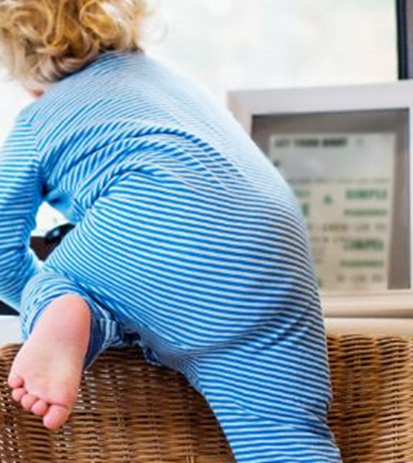
Thank you for supporting keeping children safe this Autumn.
Please Signpost parents to:
Safety advice :: Children and Family Health Surrey (childrenshealthsurrey.nhs.uk)

